Slide 1
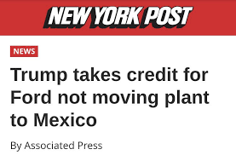
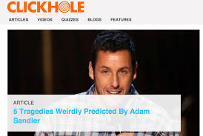
How to spot “fake news”

Slide 2
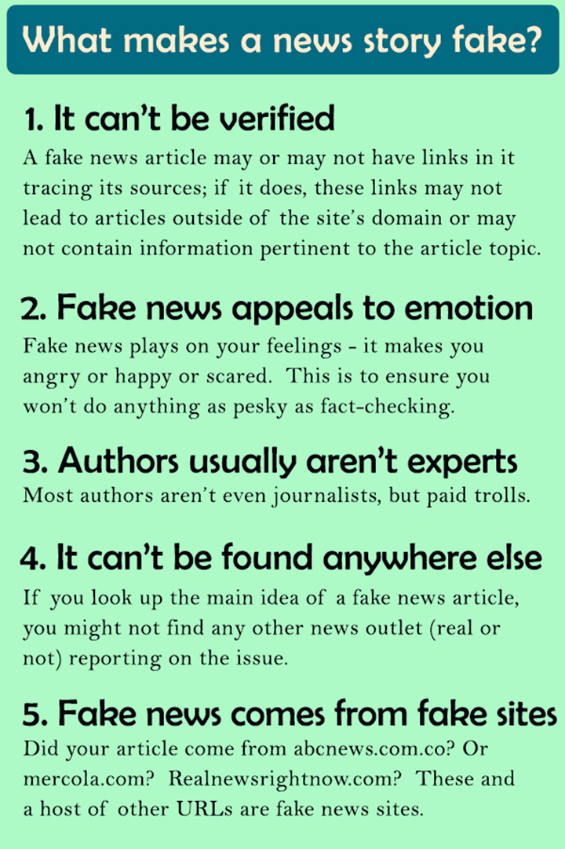
What kind of news is “fake?”
There are four broad categories of fake news, according to media professor Melissa Zimdars of Merrimack College.

Slide 3
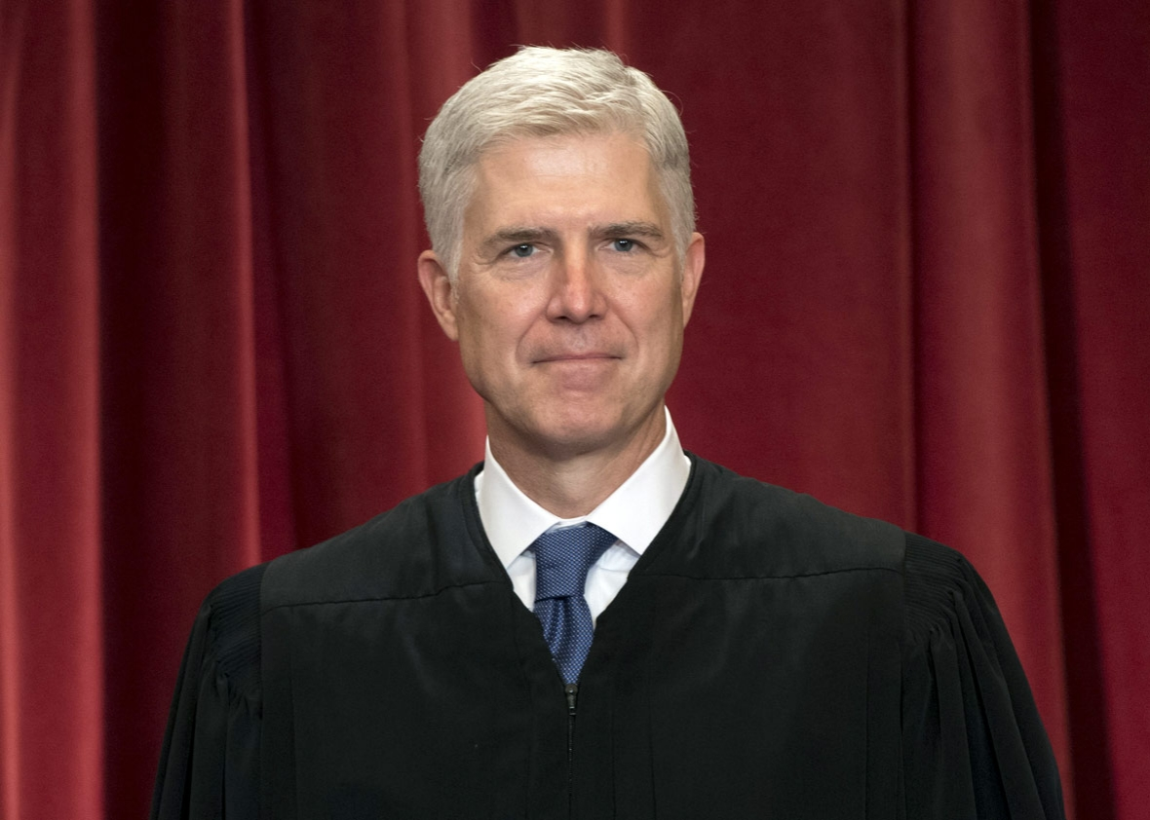
What kind of news is “fake?”
CATEGORY 1: Fake, false, or regularly misleading websites that are shared on Facebook and social media. Some of these websites may rely on “outrage” by using distorted headlines and decontextualized or dubious information in order to generate likes, shares, and profits.
Supreme Court News
Trump's Supreme Court pick Neil Gorsuch founded and led club called 'Fascism Forever' against liberal faculty at his elite all-boys DC prep school
Is this true?????

Slide 4
What kind of news is “fake?”
CATEGORY 2: Websites that may circulate misleading and/or potentially unreliable information

Slide 5
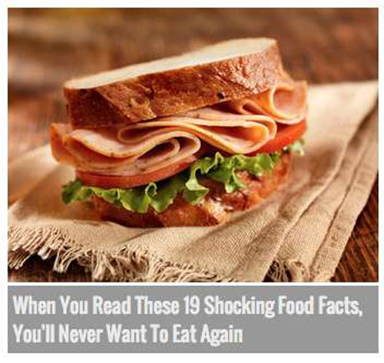
What kind of news is “fake?”
CATEGORY 3: Websites which sometimes use clickbait-y headlines and social media descriptions
Original Story

Slide 6
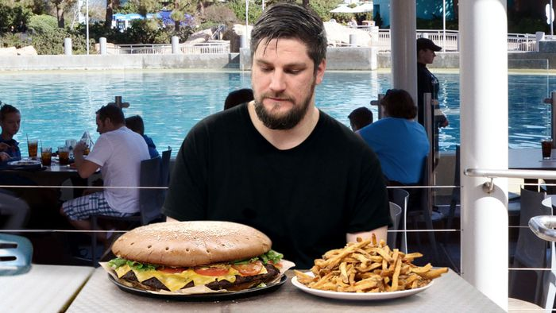
What kind of news is “fake?”
CATEGORY 4: Satire/comedy sites, which can offer important critical commentary on politics and society, but have the potential to be shared as actual/literal news
SeaWorld Café Introduces New 5-Pound Orca Burger–Eating Challenge

Slide 7
What kind of news is “fake?”
There are four broad categories of fake news, according to media professor Melissa Zimdars of Merrimack College.
CATEGORY 1: Fake, false, or regularly misleading websites that are shared on Facebook and social media. Some of these websites may rely on “outrage” by using distorted headlines and decontextualized or dubious information in order to generate likes, shares, and profits.
CATEGORY 2: Websites that may circulate misleading and/or potentially unreliable information
CATEGORY 3: Websites which sometimes use clickbait-y headlines and social media descriptions
CATEGORY 4: Satire/comedy sites, which can offer important critical commentary on politics and society, but have the potential to be shared as actual/literal news

Slide 8
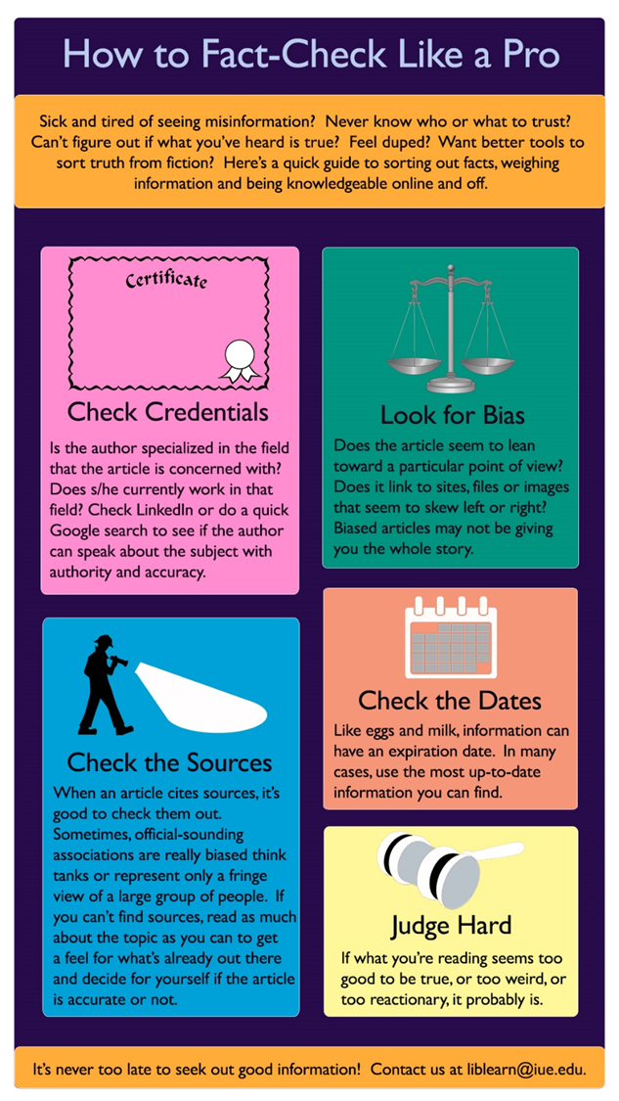
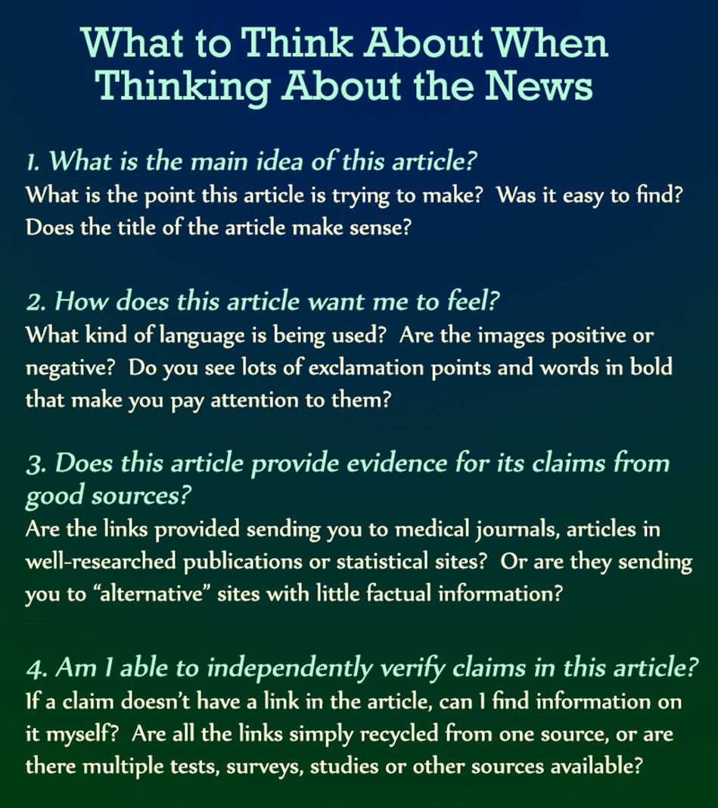

Slide 9
